Slide 1
Information Technology Consulting Services
New State Term Contract
#973-561-04-2
Effective April 1, 2004

Slide 2
Information Technology Consulting Services
Differences between the Old and New IT Consulting Contracts
Project Areas Defined: Project Oriented work versus Staff Augmentation Work
Performance Measures
How to streamline the Quotation Process

Slide 3
Information Technology Consulting Services
Background on Current IT Consulting Services
  As of August 2003, renewals made through March 31, 2004
  Existing Contracts will expire as dated but, if used, should be compared to the new pricing structure

Slide 4
Information Technology Consulting Services
Comparison to Existing IT Contracts
Previous IT Services Contract
  Vendor defined ceiling price
  State could not benchmark price
New IT Services Contract
  Leverages latest market analysis
  Contract indicates reasonable price
    Provides Ceiling Rates for Staff Augmentation
    Provides Basis for Fixed Price Task Order Negotiations for Contract Users

Slide 5
Information Technology Consulting Services
Comparison to Existing IT Contracts
Previous IT Services Contract
  Vendor-defined categories & descriptions
  Difficult to compare consultants’ services
New IT Services Contract
  Standardized categories & descriptions
    Provides organizational context
    Details job characteristics
    Specifies education & experience

Slide 6
Information Technology Consulting Services
Overview of New IT Consulting Services State Term Contract
  Project Areas
  Pricing Structure
  Purchase of Hardware or COTS
  Contractors
  Key Contract Sections

Slide 7
Information Technology Consulting Services
Functional Project Areas
4 Functional Project Areas (PA)
  PA 1: Analysis and Design
    54 Prime Vendors
  PA 2: Development and Integration
    64 Prime Vendors
  PA 3: Operational and Support
    43 Prime Vendors
  PA 4: Staff Augmentation Services
    114 Prime Vendors
  Prime vendors may have unlimited sub-vendors but administrative responsibility remains with the Prime Vendor, i.e. receipt of PO’s and Payments.

Slide 8
Information Technology Consulting Services
Functional Project Areas
PA 1: Analysis and Design
    Project Area 1 encompasses IT Planning, Studies, and Assessment to assist organizations in both information technology capital planning and assessment, including but not limited to:
    Business case analysis (e.g. costs/benefit and risk analysis)
    Performance measurements
    Independent validation and verification of systems development
    Estimating return on investment and/or earned value
    Compliance with State interoperability standards as defined by the State Technology Office

Slide 9
Information Technology Consulting Services
Functional Project Areas
PA 2: Development and Integration
    The services offered under this area include project management of systems development that organizations consider important. The services include but are not limited to the following:
    Management of systems integration
    System and software development
    Modernization of legacy systems to web enabled applications
    Software development, customization of commercial-off-the-shelf (COTS) software packages, and migration to modular applications
    Development and integration internet/intranet/web applications
    Development and integration of security, firewalls, and critical infrastructures
    Development, integration and implementation of the following:
      Networks (e.g. LAN/WAN/MAN)
      Data warehousing
      Electronic Commerce/Electronic Data interchange
      Groupware
      Next generation internet
      Client/Server computing
      Workflow and imaging

Slide 10
Information Technology Consulting Services
Functional Project Areas
PA 3: Operational and Support
    The services offered under this area include a broad range of IT related to Operations and Support Services. Anticipated services include, but are not limited to the following:
    Management and support of Local Area Networks (LANs), Metropolitan Area Networks (MANs), and Wide Area Networks (WANs)
    Computer systems administration, management and maintenance
    Data entry, data storage, data retrieval, and electronic records management
    Specialized workstation (i. e. CAD, CAD/CV, GIS) support
    Computer equipment maintenance (both on-going and on-call)
    Desktop support
    Production Support
    Database generation and database management
    Data and/or media management
    Document Imaging Services
    Disaster Recovery Services
    Orientation and training
    Information center/help desk

Slide 11
Information Technology Consulting Services
Functional Project Areas
PA 4: Staff Augmentation
    This Project Area differs greatly from the previous three, in that it does not relate to a particular part of a project lifecycle. Proposers may offer services in any of the Job Titles or Scope Variants listed on the Price Sheet. Unlike work performed within the previous three Project Areas, Staff Augmentation is not generally project-oriented. Award in Project Area 4, Staff Augmentation does not require Statewide Coverage by the Contractor.
    Proposers wishing to compete for only Project Area 4 are not required to provide pricing for all Job Titles and Scope Variants detailed on the Price Sheet. Instead, they may bid on only those Job Titles which they wish to offer. However, Contractors receiving an award in Project Area 4 will only be permitted to offer hourly staff-augmentation services for the Job Titles awarded to them (if any) under a T&M Task Order (unless the Contractor has also received an award in another Project Area).

Slide 12
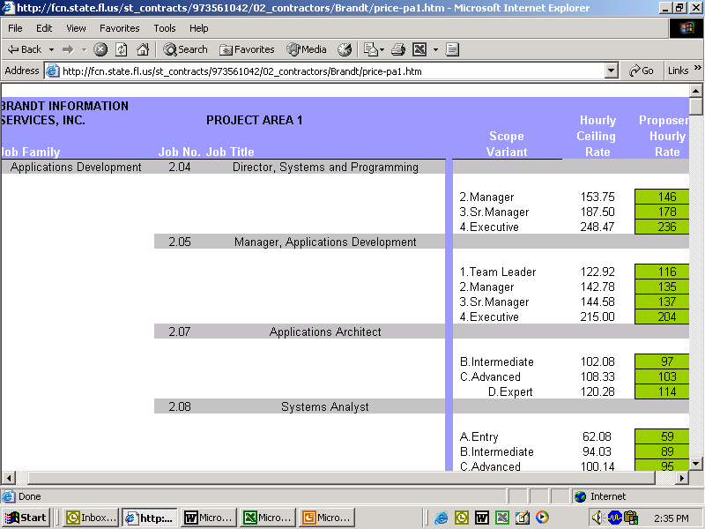
Information Technology Consulting Services
Pricing Structure

Slide 13
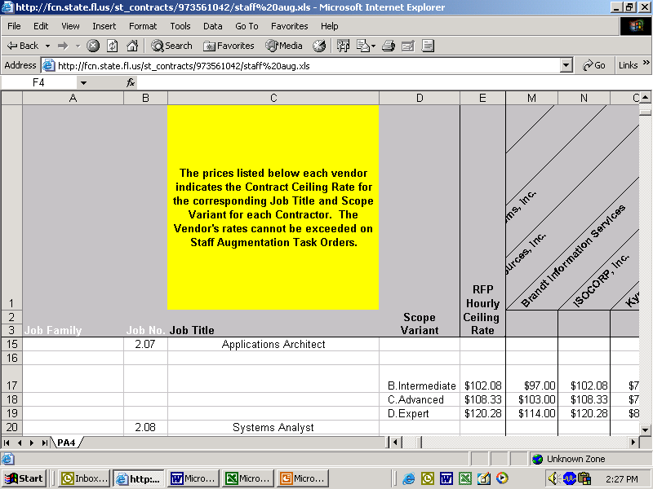
Information Technology Consulting Services
Pricing Structure

Slide 14
Information Technology Consulting Services
Purchasing Hardware and COTS
Hardware and Software purchases. This contract is NOT intended to enable purchases of IT hardware or commercial off-the-shelf (COTS) software outside of a larger IT solution. In the event that a Customer has developed a scope of work which requires hardware or COTS software as part of a delivered solution, the Customer should, in accordance with chapter 287, F.S. or other controlling law(s), seek the most cost-effective legal method of procuring such products.
Notwithstanding this general prohibition, terms and conditions addressing such items are included in this contract, in the event that the Contractor provides hardware or COTS software to the Customer in the performance of a Task Order. These provisions should not be construed by any party as authority to purchase hardware or COTS software from this Contract, independent of a larger IT solution. See Subsection 5.10, Intellectual Property.

Slide 15
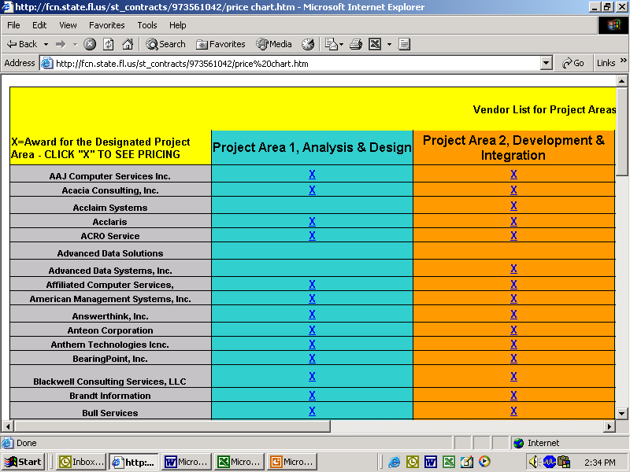
Information Technology Consulting Services
Vendor Classification Criteria

Slide 16
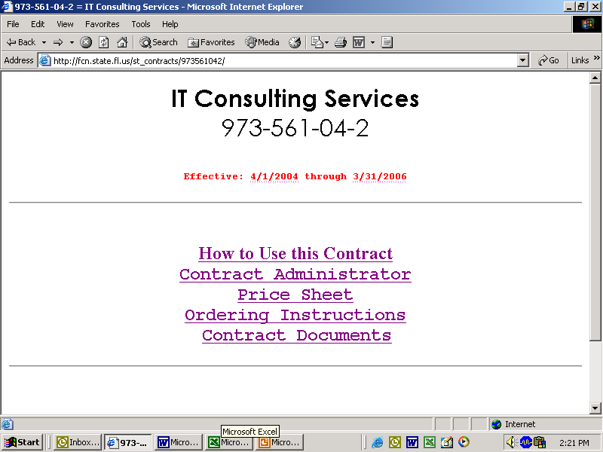
Information Technology Consulting Services

Slide 17
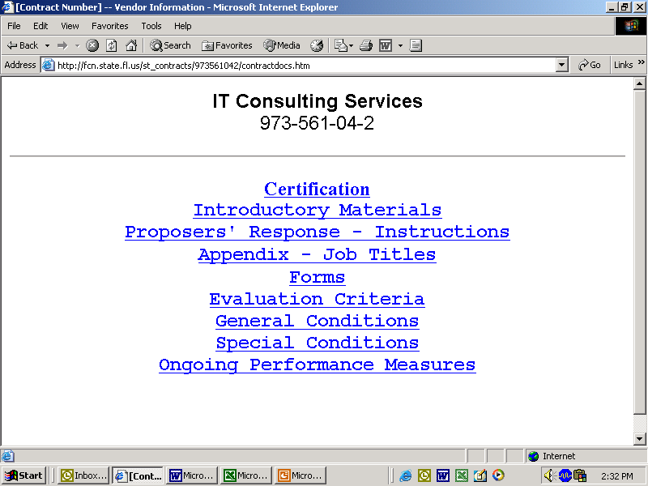
Information Technology Consulting Services

Slide 18
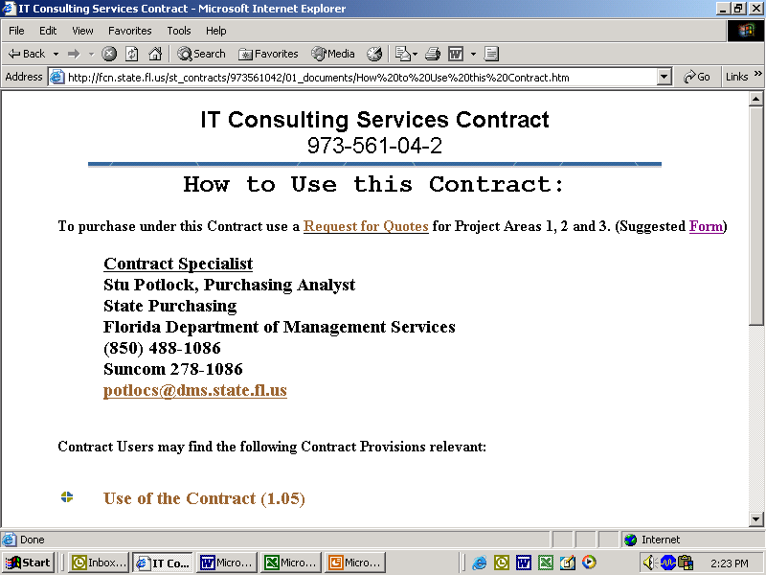
Information Technology Consulting Services

Slide 19
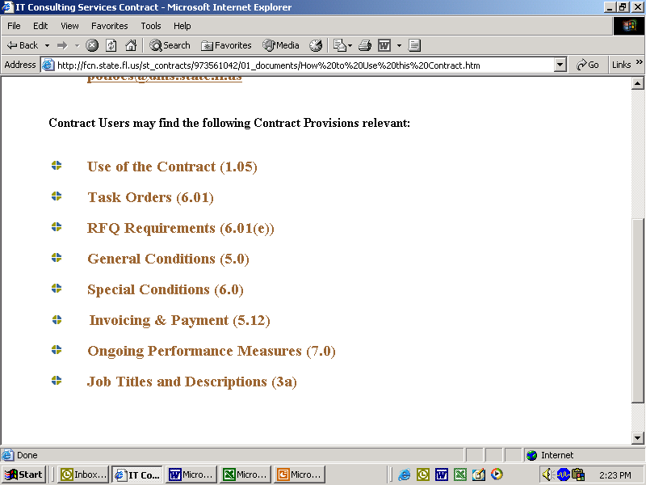
Information Technology Consulting Services

Slide 20
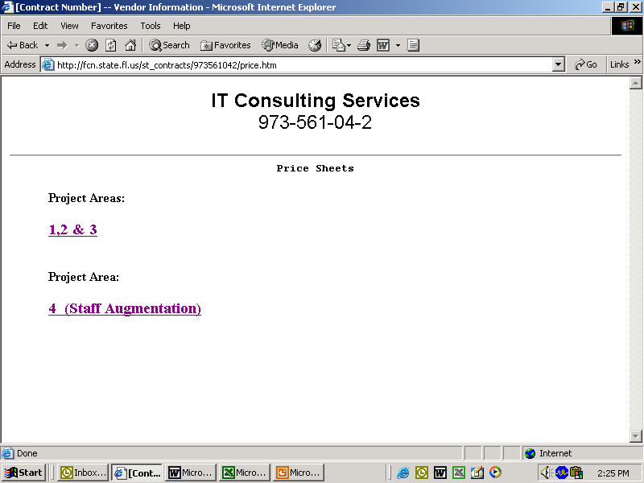
Information Technology Consulting Services
Vendor Classification Criteria

Slide 21
Information Technology Consulting Services
Ongoing Performance Measures Section 7
Ongoing Performance Measures
Table of Contents
7.01 Current Task Orders
7.02 Completed Task Orders
Forms
7.01 Current Task Orders
Contractor must submit the Current Task Orders Form to the Department's Purchasing Analyst at the beginning of each calendar quarter (that is, on January 1, April 1, July 1, and October 1 of each year). If the Contractor is not providing Services under any Task Order issued under this Contract, then Contractor is not obligated to submit a report.
The current version of this form is attached to this section 7.0.
7.02 Completed Task Orders
Upon completion of a Task Order issued pursuant to this Contract, both the Contractor and the Customer must submit comments regarding the Task Order. The Contractor must complete the Completed Task Order – Contractor Form, and the Customer must complete the Completed Task Order – Customer Form.
The purpose of these forms is to allow the State to identify opportunities for improvement in the IT consulting contracting process, and identify any problems that might relate to the use of this Contract or any particular Contractor. Such forms allow the State to continually improve it processes as well as ensure that all Contractors can consistently provide quality service to Customers.
The current versions of these forms are attached to this section 7.0.

Slide 22
Information Technology Consulting Services
Vendor Classification Criteria

Slide 23
Information Technology Consulting Services
Vendor Classification Criteria

